Slide 1
Capstone Project - The Battle of Neighborhoods
City of London

Slide 2

Increasing revenues of restaurant

Slide 3
Table of Contents
This work is presented in the following parts as shown below:
Introduction
Data
Methodology
Result
Discussion and Conclusion

Slide 4
This project is based on data from Wikipedia and Foursquare.
The London Area consists of 32 Boroughs and the "City of London". Our data will be from the link - Greater London Area https://en.wikipedia.org/wiki/List_of_areas_of_London
The Geocoder package is used to obtain the latitude and longitude of the needed locations.
The Foursquare API will be used to obtain the South East London Area venues for the geographical location data . These will be used to explore the neighborhoods of London accordingly

Slide 5
Methodology
There are total of 422 restaurants in Croydon, London out of which 52 are Indian cuisines.
The revenues of these 52 Indian restaurants has to be increased.
The population of Croydon is 372752 and I will find the average customers visiting this Indian restaurants and I will find out their orders by their visits.
A new food item with the same taste will be introduced for the customer in the next visit.

Slide 6
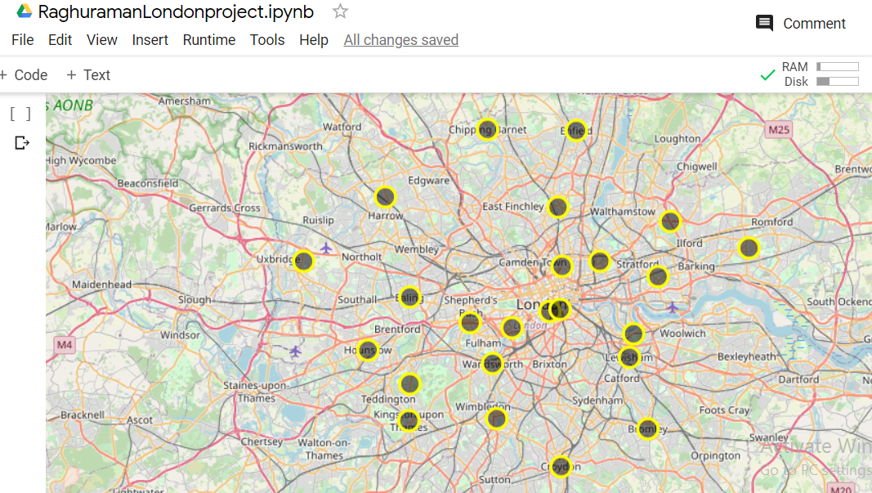
the neighbourhoods in South East London will be clustered based on the processed data

Slide 7
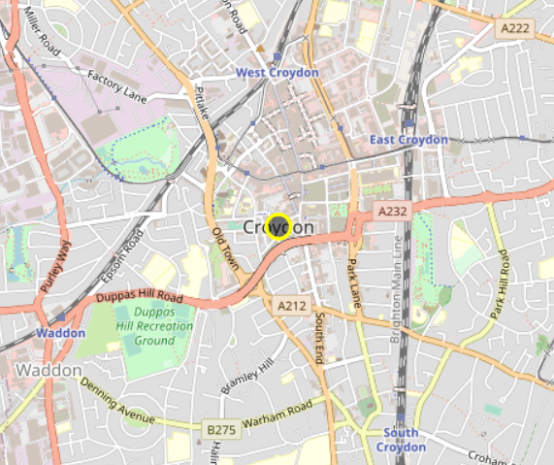
Croydon area

Slide 8
Results
The restaurant spots are identified in the folium map by the areas where the population is in huge numbers and thereby revenues can be increased with setup of new restaurants and if there are restaurants already present in that area, new food items are introduced in the menu.
Conclusions
More Indian recipes will be introduced in the Indian restaurants thereby increasing the sales of restaurants in all the boroughs of London.

